Slide 1

E-Commerce Website
AmazingOnlineShop

Slide 2

00
Branch :- Master of Computer Application
Sem :- IV
Subject :- Software Project
Code :- 649401

Slide 3
Amazing online shop
SUBMITTED BY
Students of MCA SEM IV
SUBMITTED TO
R.B. institute of management Studies

Slide 4
NO | ENROLLMENT NO | NAME
1 | 225490694039 | Rupesh Jadhav
2 | 225490694040 | Mohit Jain
3 | 225490694087 | Kashyap Prajapati

Slide 5
Index
1. Introduction
1.1. Existing System
1.2. Need for the New System
1.3. Objective of the New System
1.4. Problem Definition
1.5. Core Components
1.6. Project Profile
1.7. Assumptions and Constraints
1.8. Advantages and Limitations of the Proposed System
2. Requirement Determination & Analysis
2.1. Requirement Determination
2.2. Targeted Users
3. System Design
3.1. Use Case Diagram
3.2. Class Diagram
3.3. Interaction Diagram
3.4. Activity Diagram
3.5. Data Dictionary
4. Screenshots of main modules

Slide 6
Introduction
The exchange of Goods and services for money
Online Shopping is a form of electronic commerce which allows consumers to directly buy goods or service from a seller our internet using a web browser.
Consumer find a product of interest by visiting the website of the retails directly or by searching among alternative vendors using a shopping search engine, which display the same products availability and pricing at different e-retailers.
Online stores usually enable shoppers to use “search” features to find specific models, brands or items.
Consumers are attracted to online shopping not only because of broader access to information.
Buyers :- these are people with money who want to purchase a good or service.
Seller :- these are the people who offers goods and services to buyers.

Slide 7
Existing System
The current system for shopping is to visit the shop manually and from the available product choose the item customer want and buying the item by payment of the price of the item .
It is less user-friendly.
User must go to shop and select products.
It is difficult to identify the required product.
Description of the product limited
It is a time consuming process.
Not in reach of distant users.

Slide 8
Need for the New System
In the new system customer need not go to the shop for buying the products. He can order the product he wish to buy through the application in his Smartphone.
The shop owner will be admin of the system. Shop owner can appoint moderators who will help owner in managing the customers and product orders. The system also recommends a home delivery system for the purchased products.

Slide 9
Objective of the New System
Our product will be the online shopping items.
Our website will be product based service.
We are using B2C type of business model.
B2C means business to customer model where the companies will be selling their goods to the customers directly using our services.

Slide 10
Advantages and Limitations of the Proposed System
Online shopping provides access to a vast range of products from various sellers and brands. Shoppers can easily compare prices, read product reviews, and find unique or niche items that may not be available in local stores.
Online shopping saves time and effort by eliminating the need for travel, parking, and waiting in queues. It also allows shoppers to compare prices easily, find discounts, and take advantage of exclusive online deals, leading to potential cost savings.
Online retailers typically offer home delivery services, bringing purchased items directly to the customer's doorstep. Delivery tracking systems allow customers to monitor the progress of their shipments and plan accordingly.

Slide 11
Project Profile
Explore a vast assortment of products across multiple categories. Effortless search and filtering: Quickly find what you need with our intuitive search and filtering options.
Secure transactions: Shop with confidence using our secure payment gateways.
Experience fast and reliable delivery straight to your door step.
Personalized recommendations: Discover tailored product suggestions based on your preferences.
User-friendly interface: Enjoy seamless navigation with our intuitive app design.

Slide 12
Technology Selected for Proposed System
HTML
Java script
CSS
Language :- PHP
Framework :- Laravel
Data Base :- MYSQL

Slide 13
Our website will be having two types of users.
Core Components
CUSTOMER
ADMIN

Slide 14
WHAT CUSTOMER’S CAN DO
Customers can order the product.
Customers can see the descriptions of the products.
For buying/ordering the product the customer must login first.
After ordering the product customers can check their order status.
Customer can review the products.
Customer can change their password.

Slide 15
WHAT Admin CAN DO
Admin can first have to register themselves for selling their products on the site.
After registrations will be having access to the sellers module where he can insert his/her products.
The product information will be including the :- Name, Price , Description , Image and quantity of the product which is in his inventory.
After the insertion of the product if a customer places order of product from your shop/company then you will receive the order.
Admin have to pack the order and have to maintain the order of the inventory as long as logistic guy arrive and take the package with him.
After this Admin will be receiving his payment.

Slide 16
Requirement Determination & Analysis

Slide 17
CUSTOMER
1. Login/register
2. Search product
3. Display/View product/Browse the website.
4. Add product to the cart.
5. Ordering of product / Conformation of product.
6. Payment Method[COD/Online Payments]
7. Tracking of Product.
8. Reciving the product.
9. Payment if opt for [COD]
10. Feedback/rating [Not mandatory]

Slide 18
Admin
1. Login/register
2. Add new Product
3. Manage Items in product list.
4. Manage the live orders.
5. Check the product quantity in warehouse/store.
6. Pack the product.
7. Recive the online payments.
8. Manage the feedbacks[If provided]

Slide 19
Flow chart, System Design

Slide 20
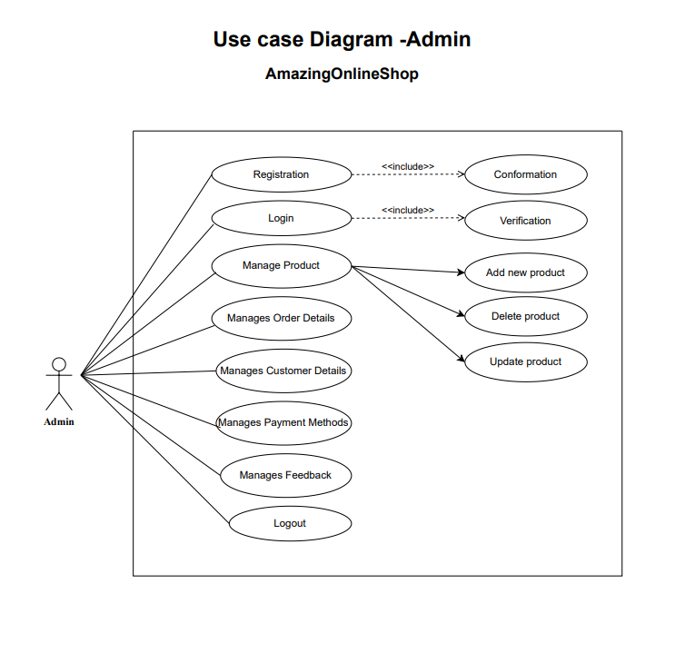

Slide 21
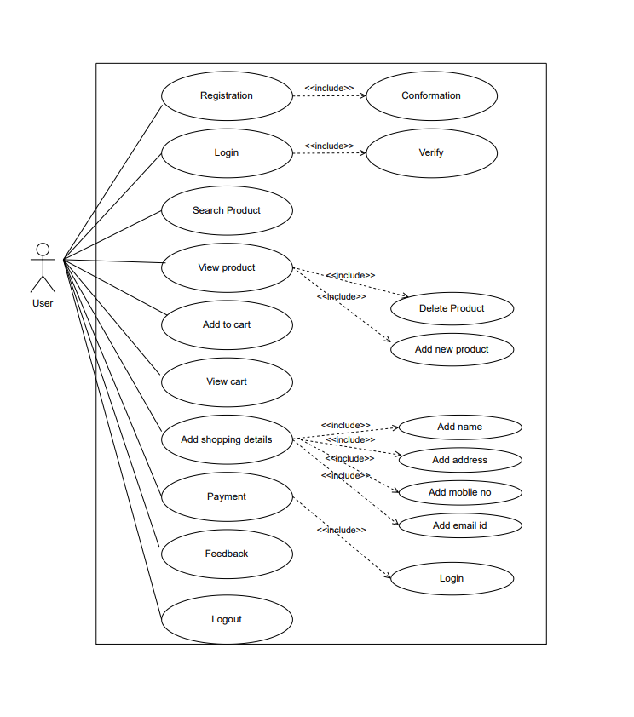
Use Case diagram :- User

Slide 22
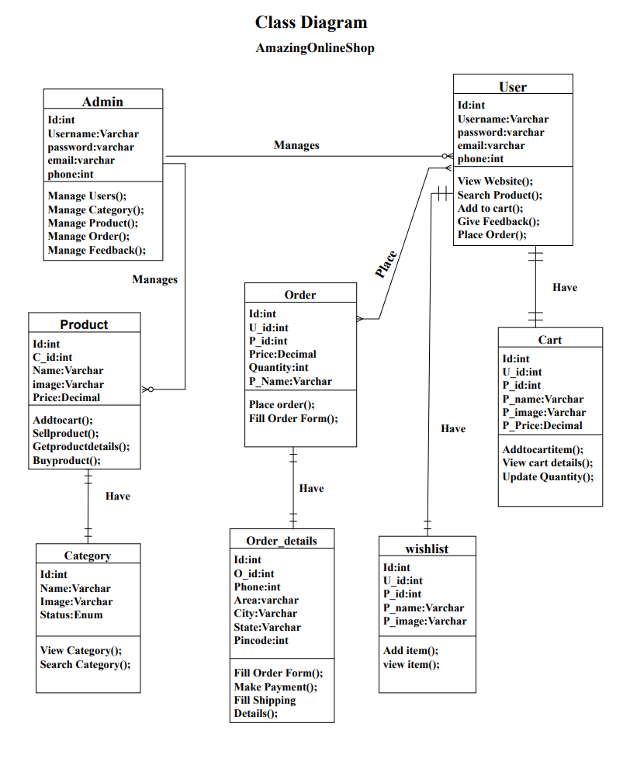

Slide 23
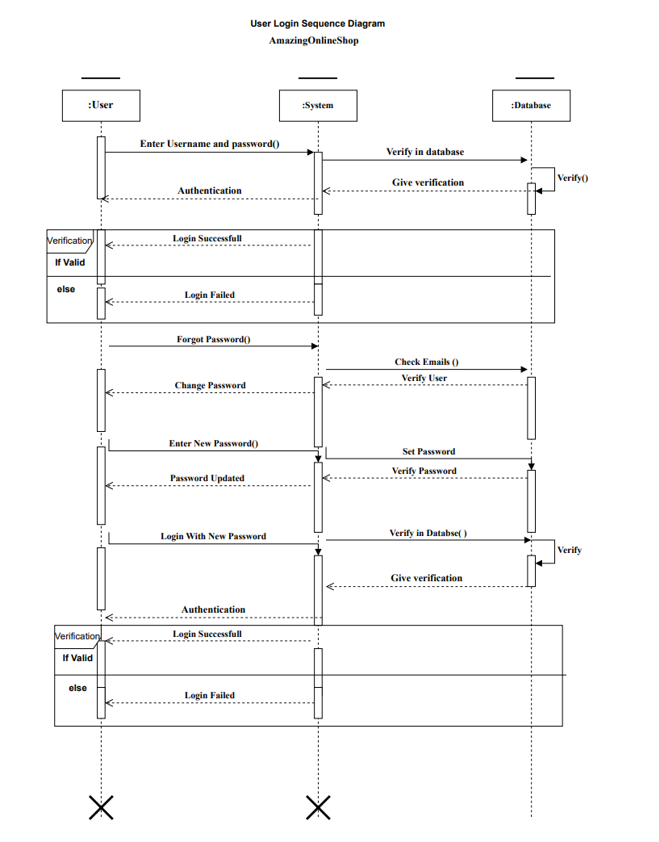
Interaction Diagram :- User Login

Slide 24
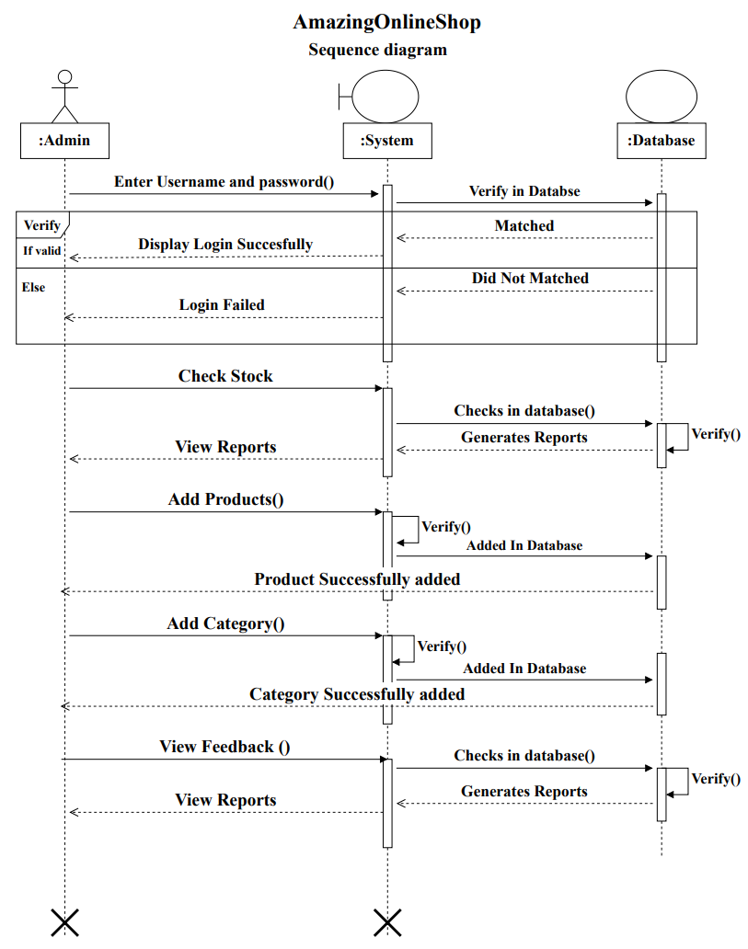
Interaction Diagram :- Admin

Slide 25
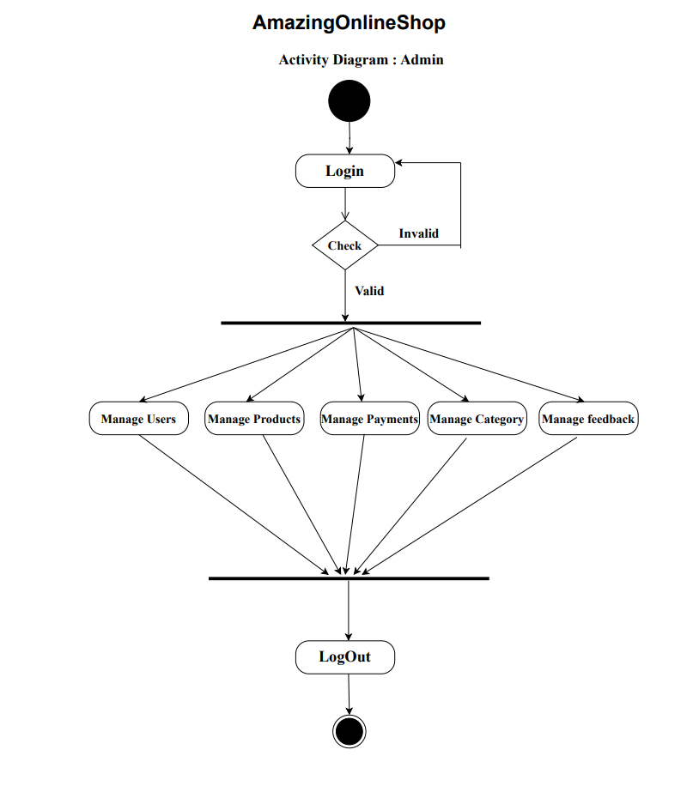
activity Diagram :- Admin

Slide 26
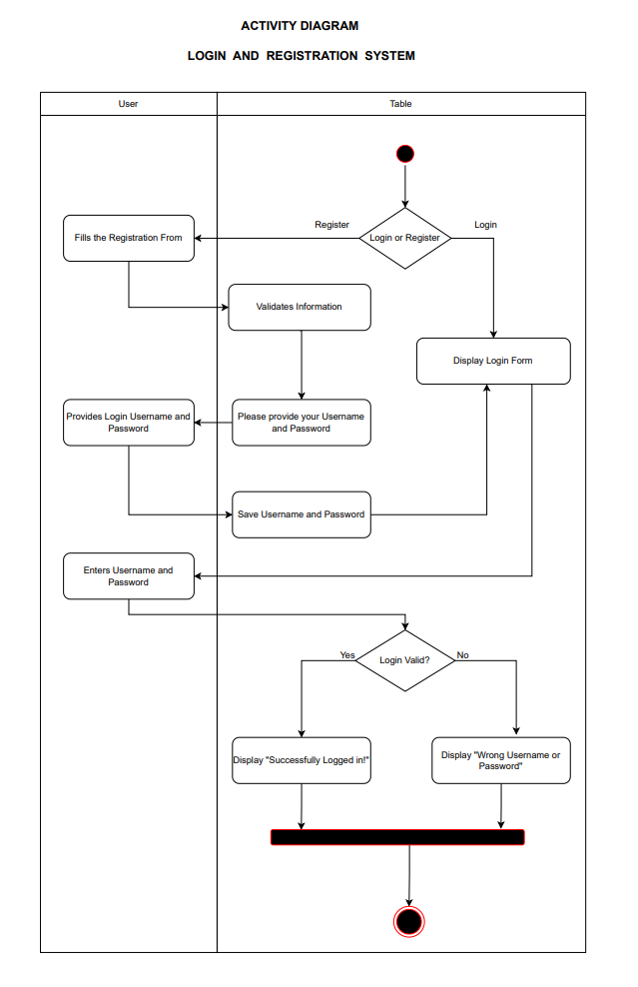
activity Diagram :- USer

Slide 27
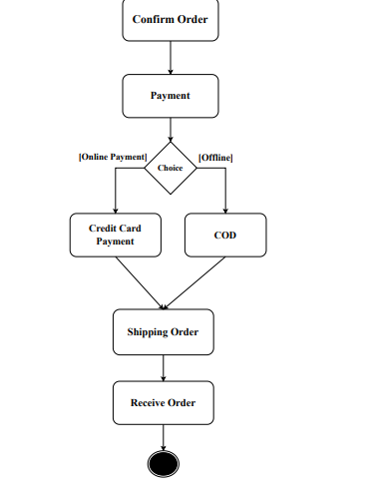
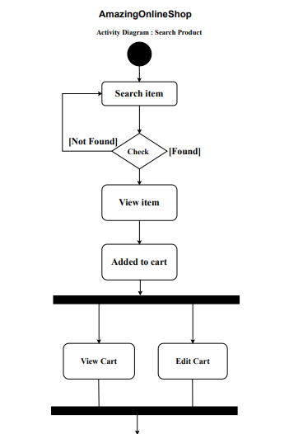
activity Diagram :- Search product

Slide 28
Data flow diagrams

Slide 29
Zero Level DFD
0
Online Shopping System
Admin
Customer

Slide 30
first Level DFD
1.0
Create Account
Login/Registration
Login/Registration
Customer
Admin
Response
Response
2.0
Order
Insert/ Change /update
catalogue
Browse
Purchase Request
Order Request
3.0
Payment
Manage Conformation
Conformation message
Make Payment
Receive Payment

Slide 31
second Level DFD
Customer
Admin
Registration info
1.1
Register
response
information
Registration db
response
Login info
1.2
login
Login info
response
response
Information fetching
response
Login db
Request for password / Update profile
1.3
Forgot pass/ update profile
Request for password / Update profile
response
Response from server
Response from server
product db
Information fetching/editing

Slide 32
customer
request for cart view
Admin
2.1
Add prduct
response
request
Order db
response
2.2
View/select product
Order selection request
Display the selected request
response
response
response
request
Order_con db
response
Order/ cancel the product
2.3
Order/ cancel
Update Dispatch/cancel order
response
request
Order_deliv db
response

Slide 33
customer
Payment method selection
Admin
3.1
View bill
request
Response
Payment db
Response
3.2
Online payment
Send the payment
Receive the payment
request
Payment info
Response

Slide 34
Data Dictionary

Slide 35
User table
Sr.No | Field Name | Data Type | Size | Key | Description
1 | Id | integer | 20 | PK | Auto increment
2 | name | varchar | 191 | NN | User’s Name
3 | Email | varchar | 191 | NN | Email Id of User
4 | role | varchar | 191 | NN | Type of User
5 | phone | varchar | 191 | NN | Mobile no of User
6 | status | integer | 11 | NN | User Address
7 | password | varchar | 191 | NN | Password of User

Slide 36
Brand table
Sr.No | Field Name | Data Type | Size | Key | Description
1 | Id | integer | 20 | PK | Auto increment
2 | name | varchar | 191 | NN | Brand Name
3 | slug | varchar | 191 | NN | Sulg unique in table
4 | status | varchar | 191 | NN | Status of brand
5 | Created_at | varchar | 191 | NN | Created time
6 | Updated_at | varchar | 191 | NN | Updated Time

Slide 37
Categories table
Sr.No | Field Name | Data Type | Size | Key | Description
1 | Id | integer | 20 | PK | Auto increment
2 | name | varchar | 191 | NN | Category Name
3 | slug | varchar | 191 | NN | Sulg unique in table
4 | status | varchar | 191 | NN | Status of category
5 | image | varchar | 191 | NULL | Image Of Category
6 | showHome | Enum | ‘Yes’,’No’ | NN | Show on Home Page Or Not
7 | Created_at | varchar | 191 | NN | Created time
8 | Updated_at | varchar | 191 | NN | Updated Time

Slide 38
Discount coupon table
Sr.No | Field Name | Data Type | Size | Key | Description
1 | Id | integer | 20 | PK | Auto increment
2 | code | varchar | 191 | NN | Code
3 | name | varchar | 191 | NN | Coupon name
4 | description | text |  | NULL | Description
5 | max_uses | Integer | 11 | NULL | Maximum Use of coupon
6 | max_uses_user | Integer | 11 | NULL | Maximum Use for 1 User
7 | type | Enum | ‘percent’,’fixed’ | NN | Discount is fix or percent
8 | discount_amount | Double | 10,2 | NN | Amount
9 | min_amount | Double | 10,2 |  | Minimum Amount is require
10 | status | Integer | 11 | NN | Active or not
11 | Created_at | varchar | 191 | NN | Created time
12 | Updated_at | varchar | 191 | NN | Updated Time

Slide 39
Product Table
Sr.No | Field Name | Data Type | Size | Key | Description
1 | id | Integer | 10 | PK | Auto increment
2 | title | varchar | 191 | NN | Product’s name
3 | slug | Varchar | 191 | NN | Unique in table
4 | description | varchar | 191 | NN | Product’s Description
5 | Category_id | Integer | 11 | FK | Product’s category
6 | Sub_category_id | Integer | 11 | FK | Product’s sub category
7 | Brand_id | Integer | 11 | FK | Product’s Brand
8 | price | float | predefined | NN | Product’s Price
9 | discount_price | float | predefined | NN | Product’s Discount Price
10 | Qty | Integer | 11 | NN | Product’s Quantity

Slide 40
Order Table
Sr.No | Field Name | Data Type | Size | Key | Description
1 | id | Integer | 11 | PK | Auto increment
2 | user_id | Integer | 11 | NN | User’s Id
3 | subtotal | double | 10,2 | NN | Total Amount
4 | shipping | Double | 10,2 | NN | Shipping Charge
5 | Coupon_code | Varchar | 191 | NULL | Coupon Code Use By User
6 | Discount | Double | 10,2 | NULL | Discount Amount
7 | grand_total | Double | 10,2 | NN | Amount to be paid
8 | Payment_status | Enum | ‘paid’,’not paid’ |  | Payment Status of order
9 | Payment_mode | Enum | ‘cod’,’card’ |  | Payment Mode

Slide 41
Order items table
Sr.No | Field Name | Data Type | Size | Key | Description
1 | id | Integer | 11 | PK | Auto increment
2 | Order_id | Integer | 11 | FK | Order Id
3 | Product_id | Integer | 11 | FK | Product Id
4 | Name | varchar | 191 | NN | Product Name
5 | Qty | integer | 11 | NN | Product Quantity
6 | Price | Double | 10,2 | NN | Product Price
7 | Total | Double | 10,2 | NN | Total Amount
8 | Created_at | timestamp |  |  | Date of Order

Slide 42
Detailed Process of Proposed system (Field & screens)

Slide 43
Screenshots of main modules CUSTOMER

Slide 44
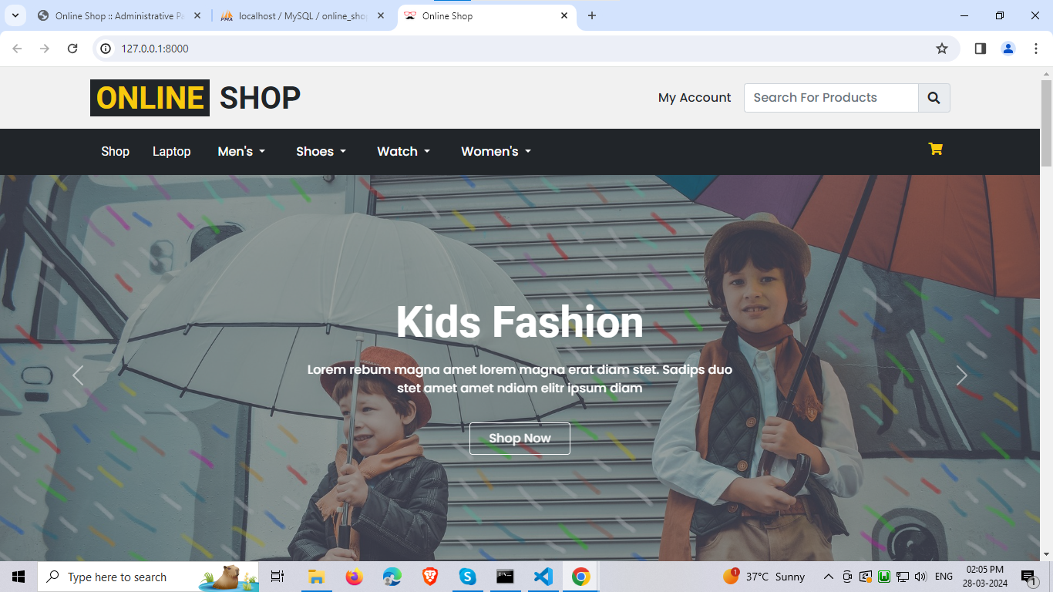
Home page

Slide 45
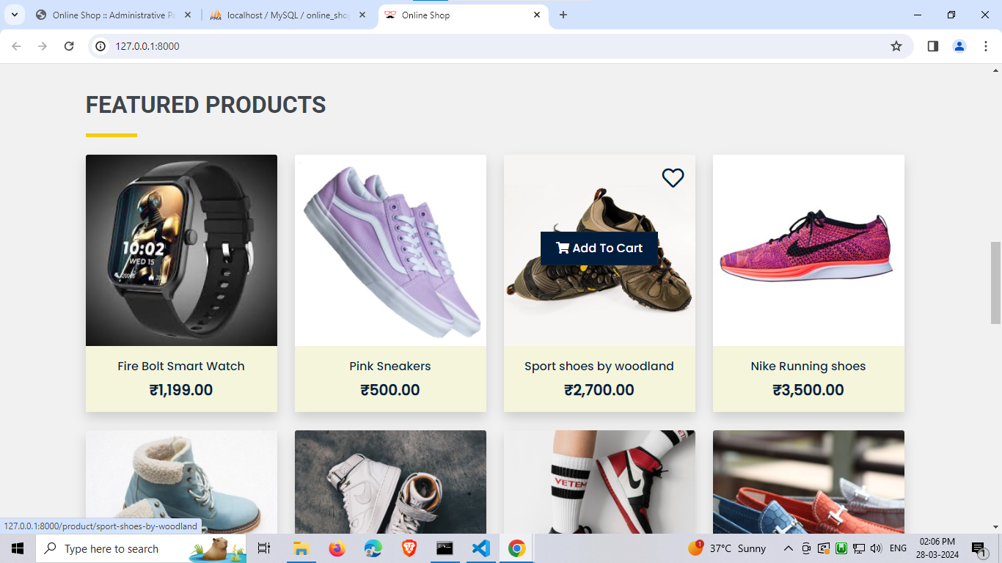
Scrolled homepage

Slide 46
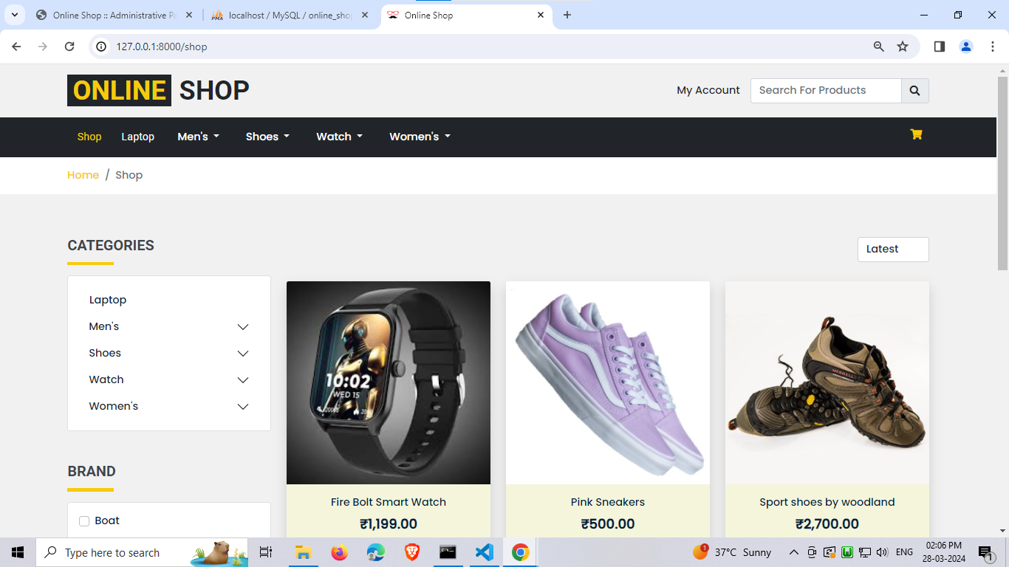
Shop page

Slide 47
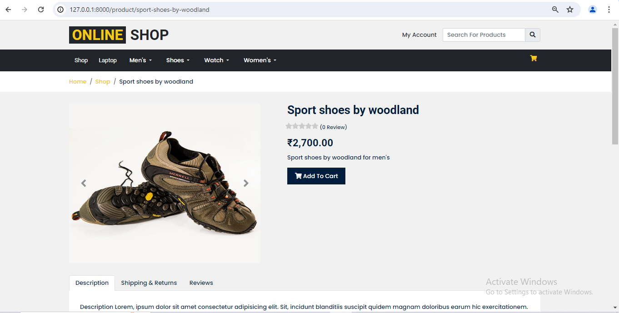
Selected product page

Slide 48
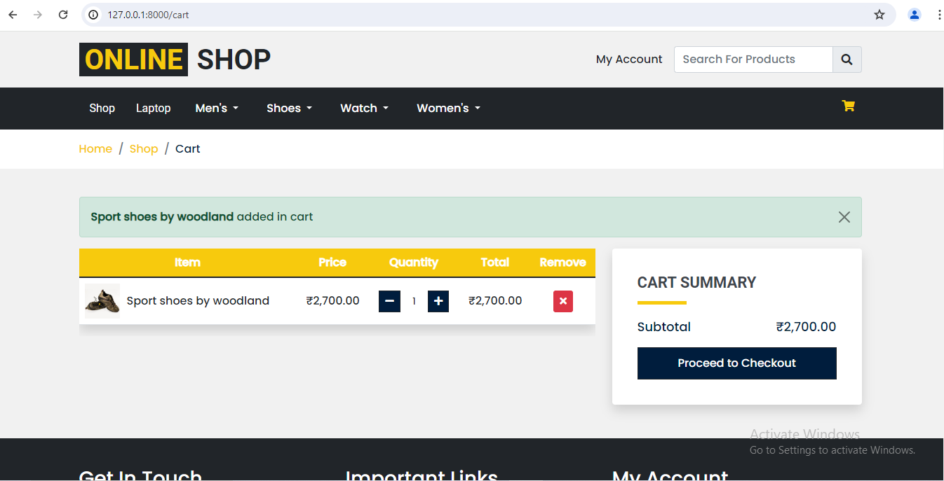
CART PAGE

Slide 49
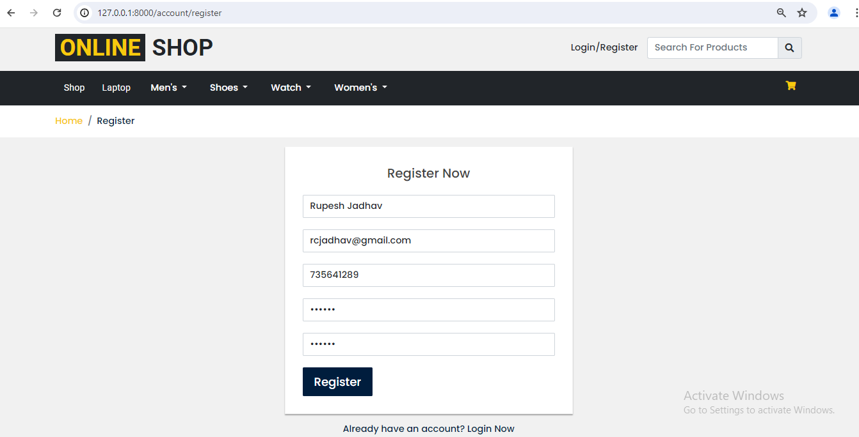
Registration page

Slide 50
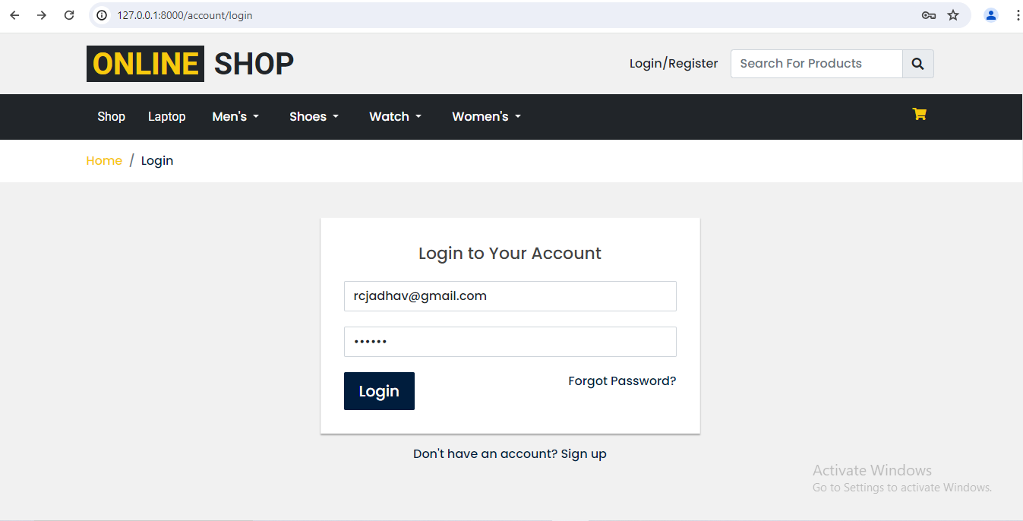
Login Page

Slide 51
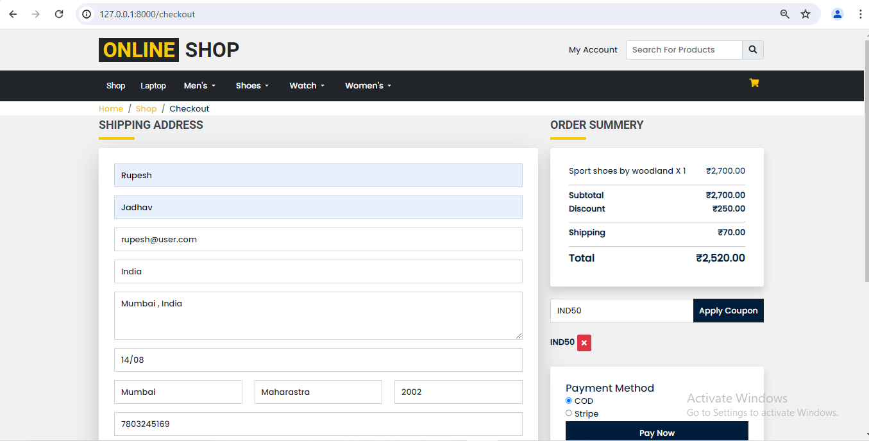
Checkout page

Slide 52
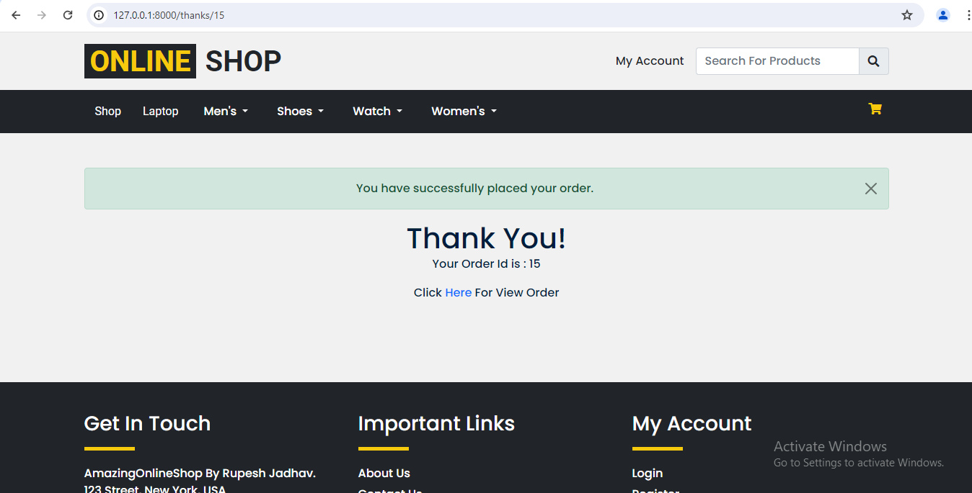
Order success page

Slide 53
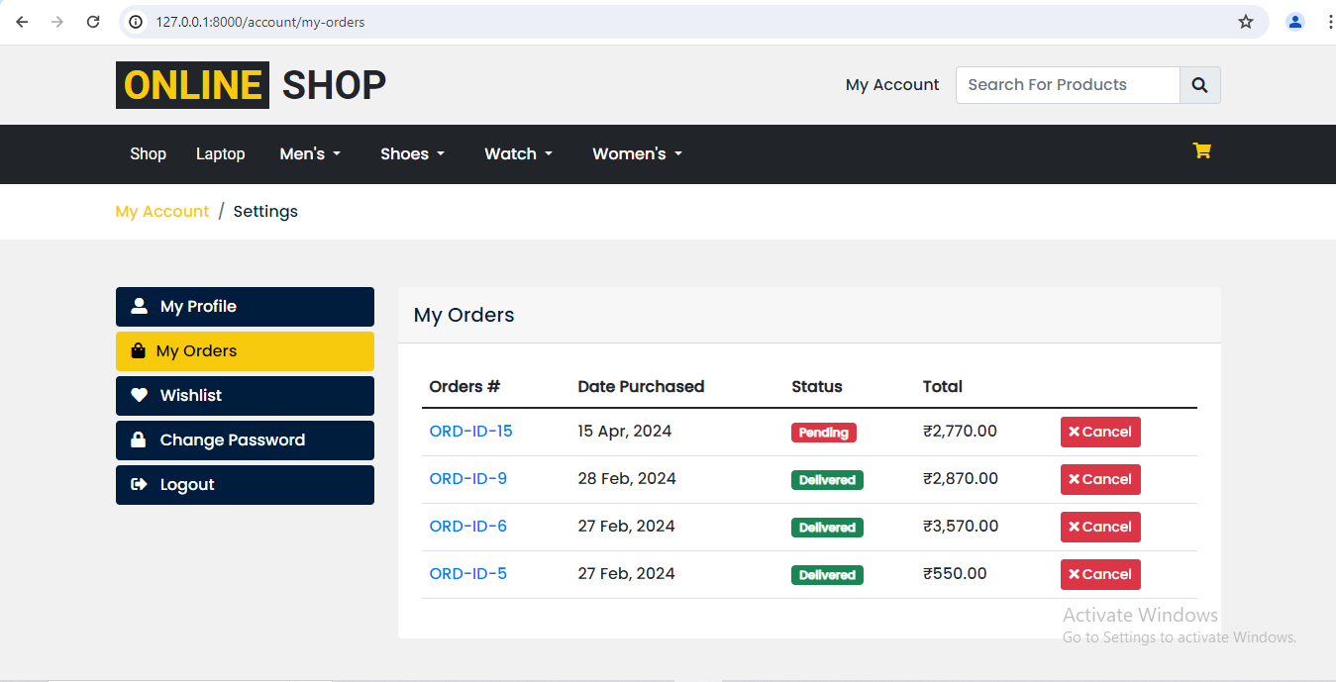
My Orders Page

Slide 54
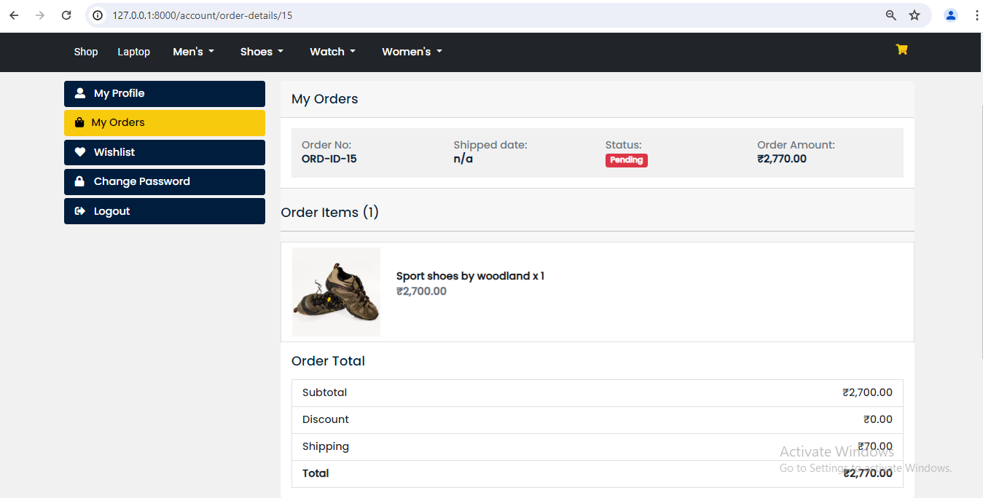
Order Details page

Slide 55
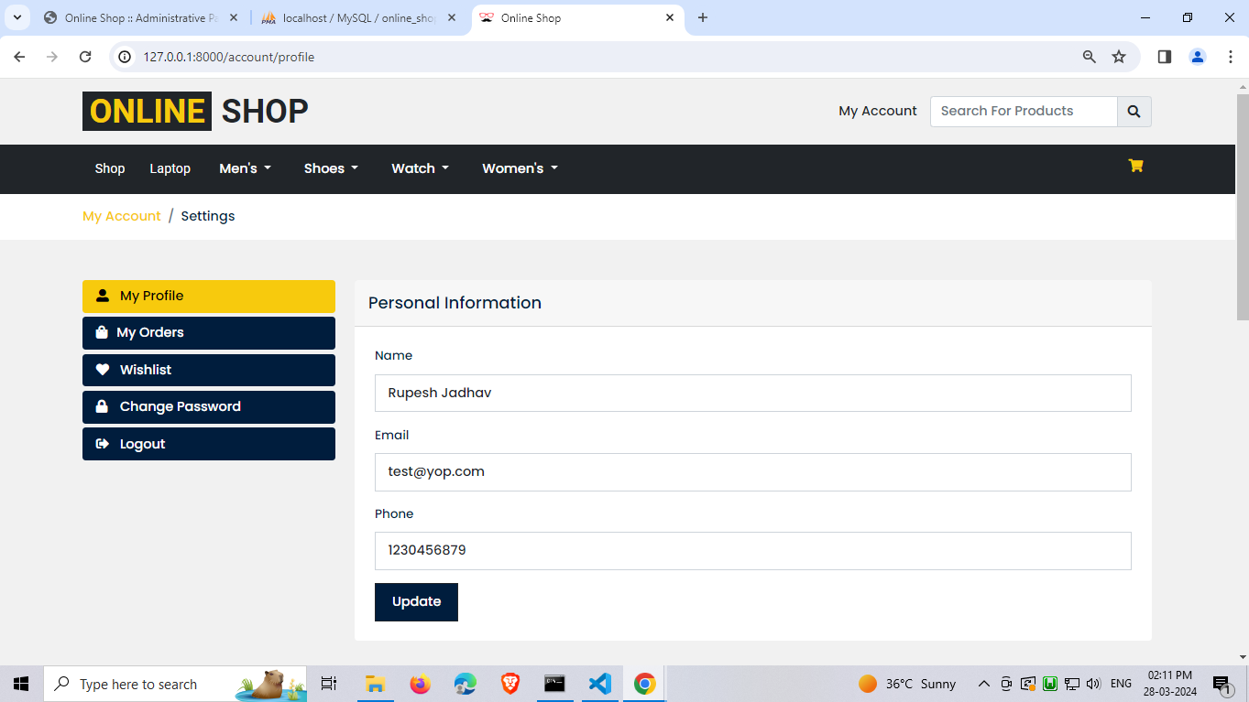
Profile page

Slide 56
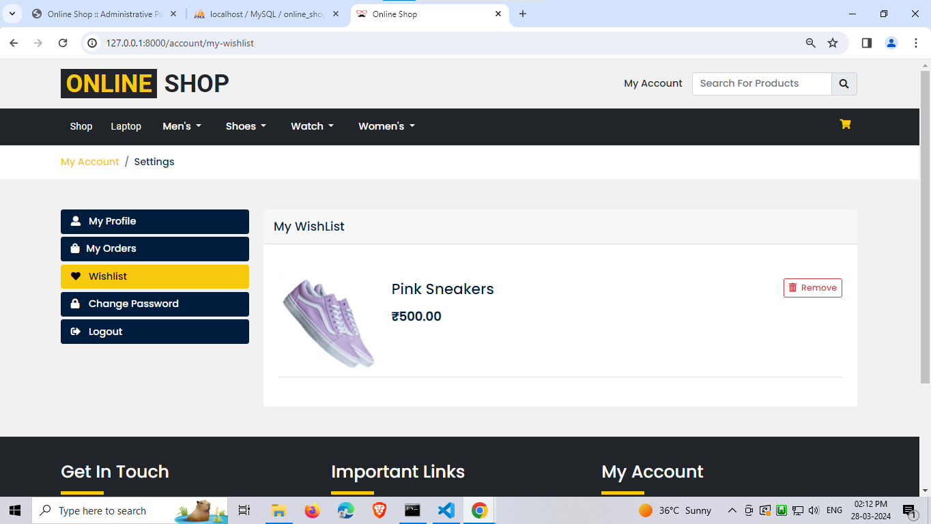
wishlist PAGE

Slide 57
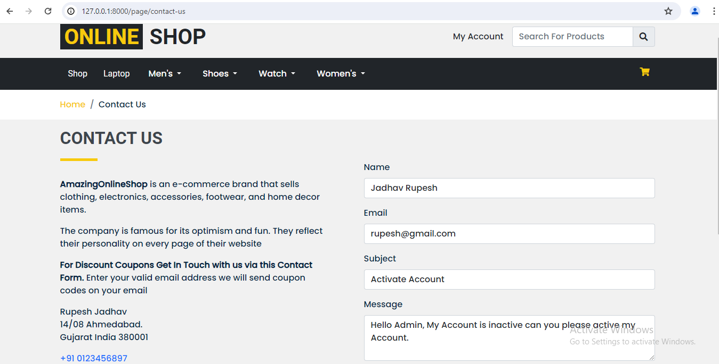
Contact-us page

Slide 58
ADMIN

Slide 59
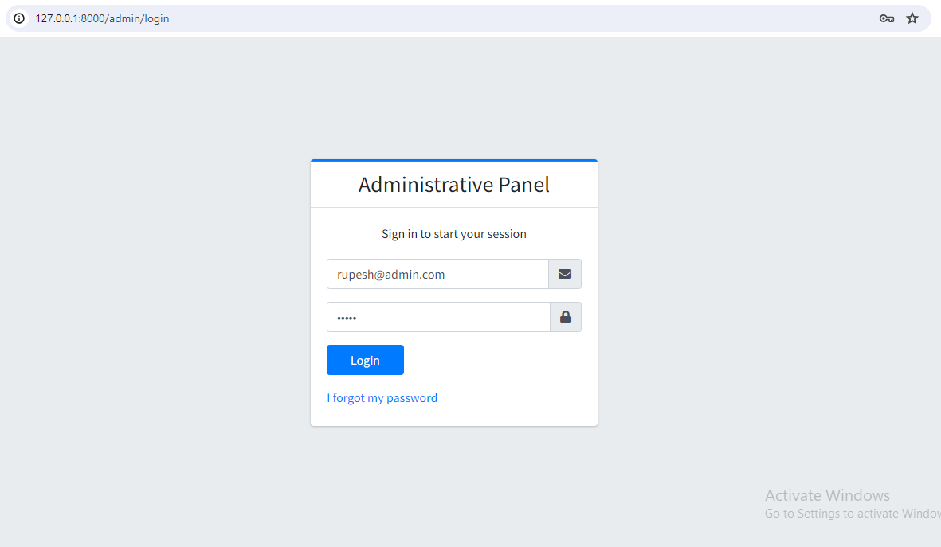
Admin Login

Slide 60
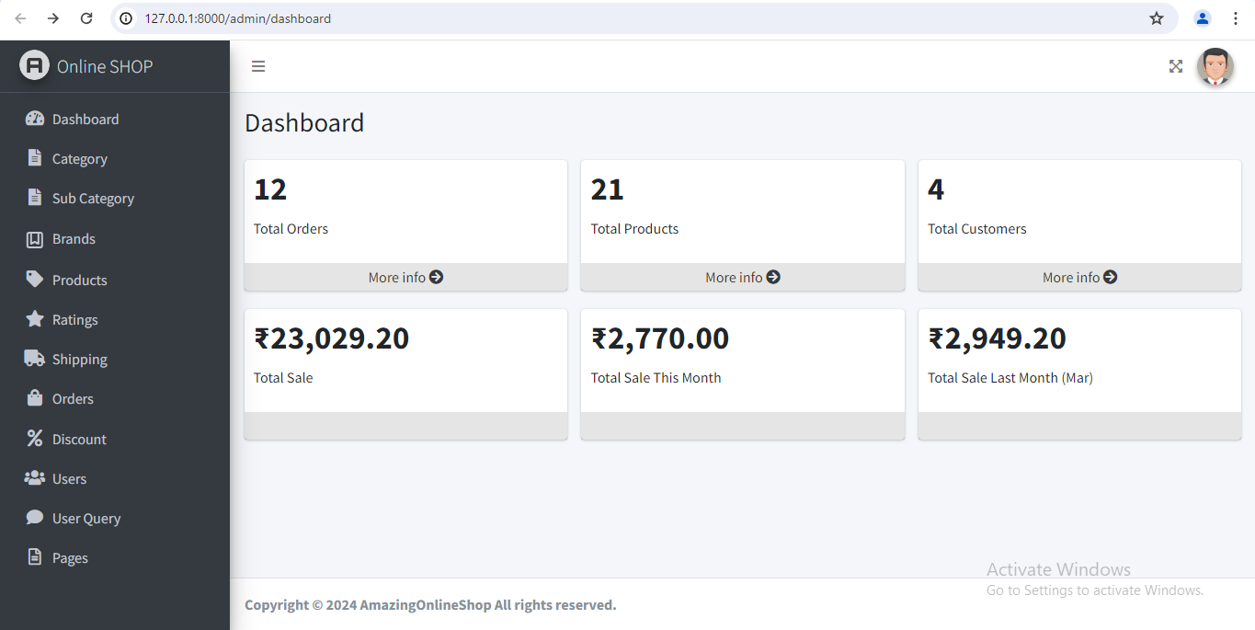
Admin Dashboard

Slide 61
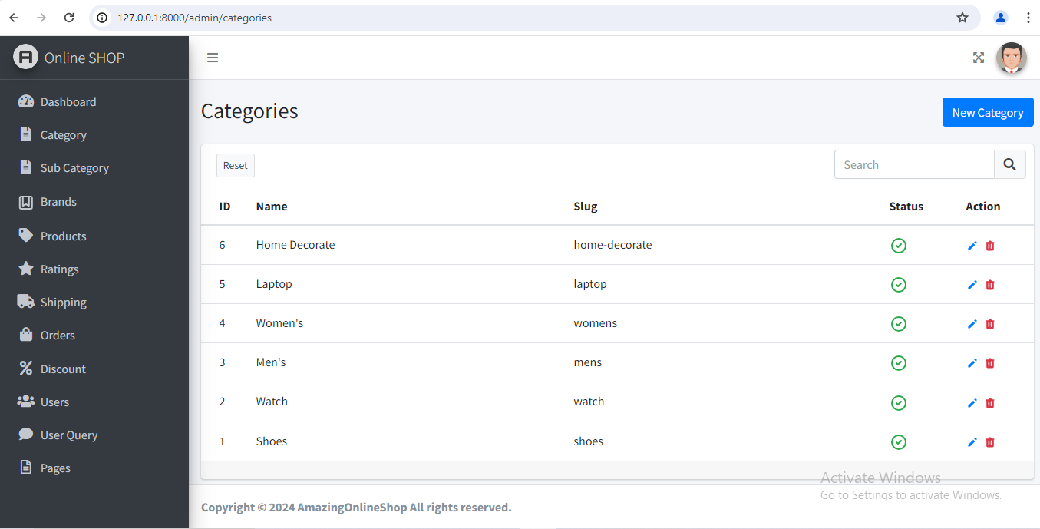
category page

Slide 62
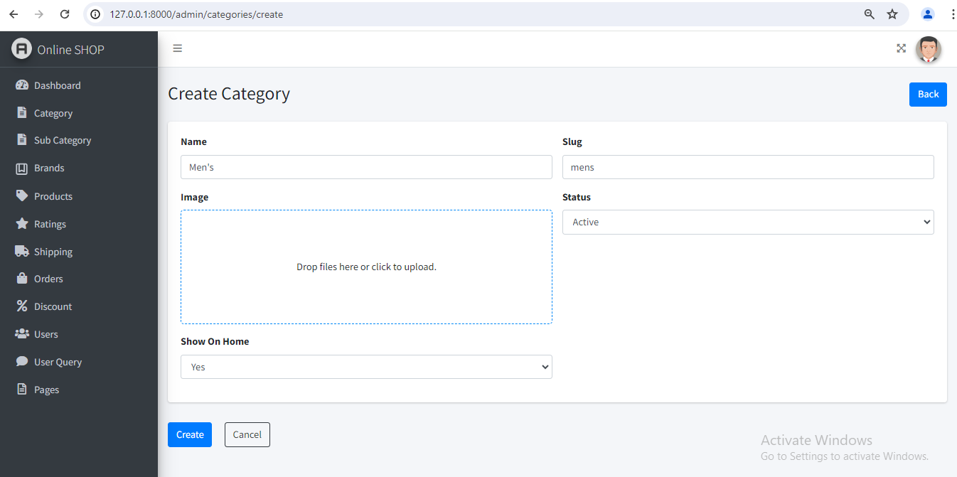
Add category page

Slide 63
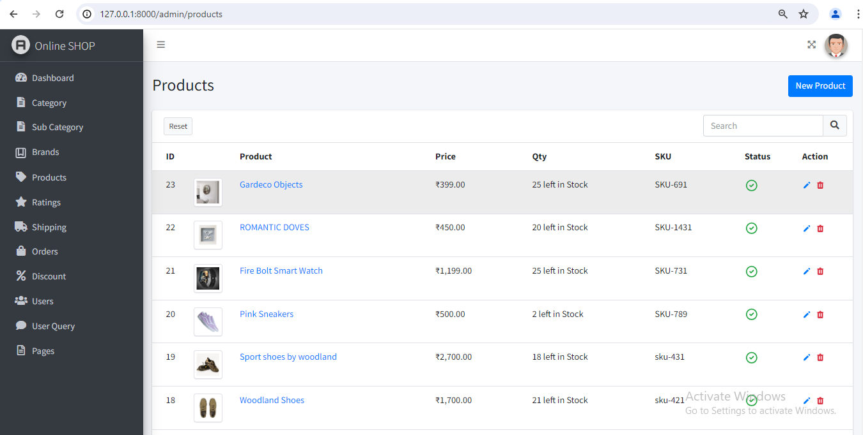
Product Listing page admin

Slide 64
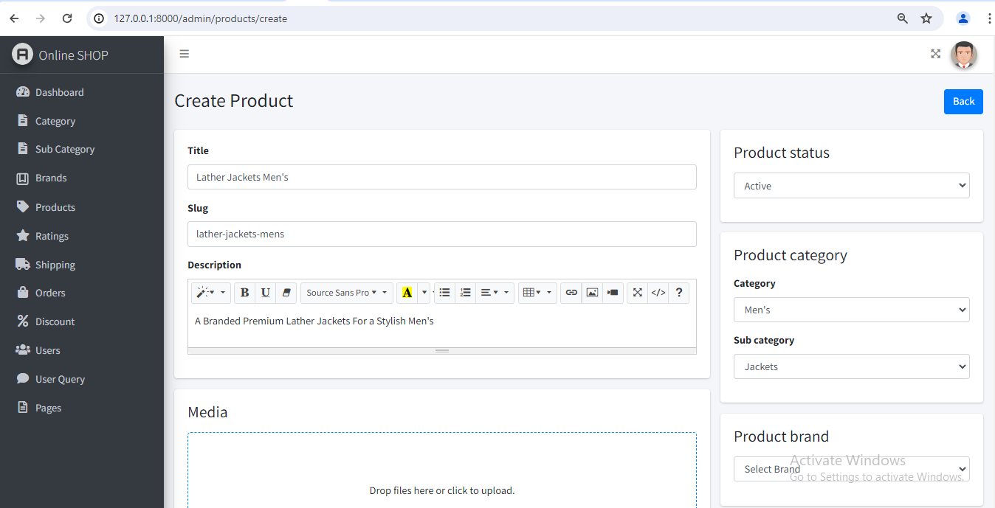
Add product page

Slide 65
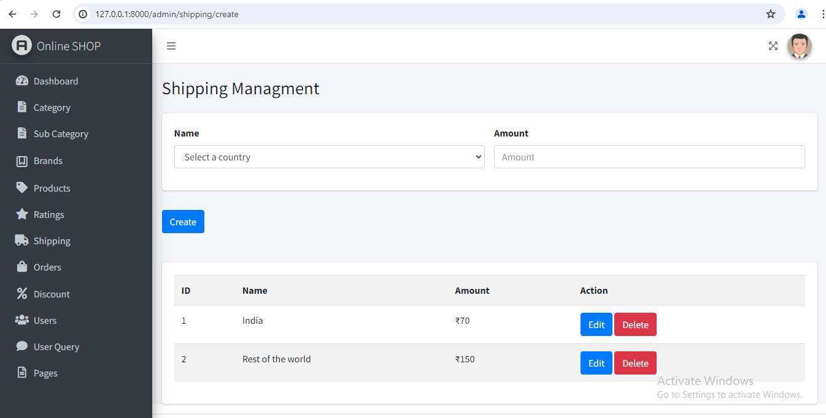
Shipping page Admin

Slide 66
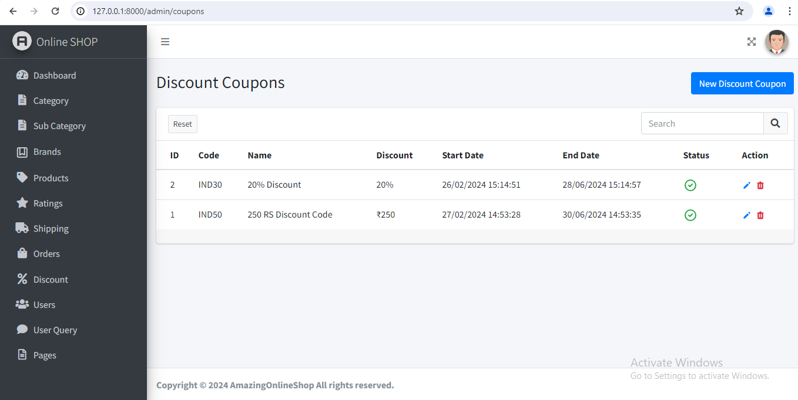
coupon page Admin

Slide 67
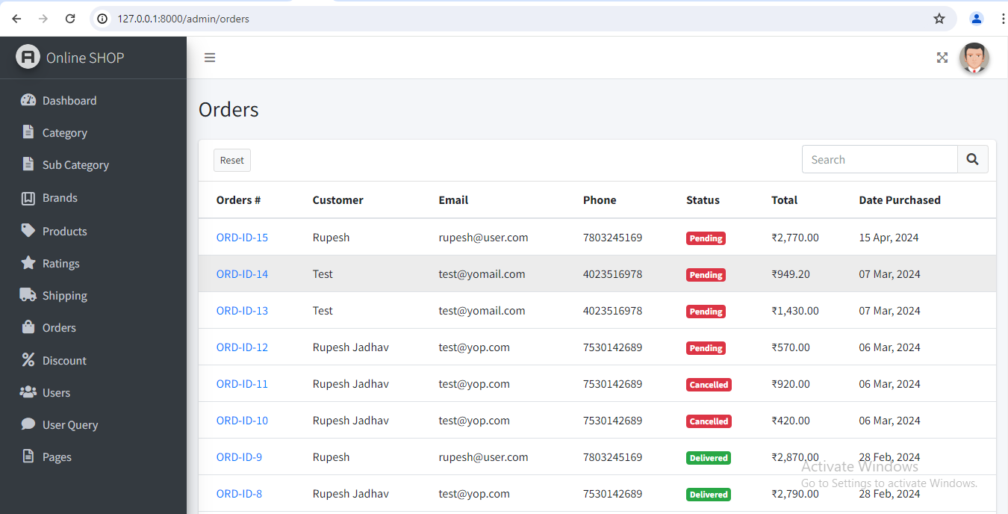
order Listing Admin side

Slide 68
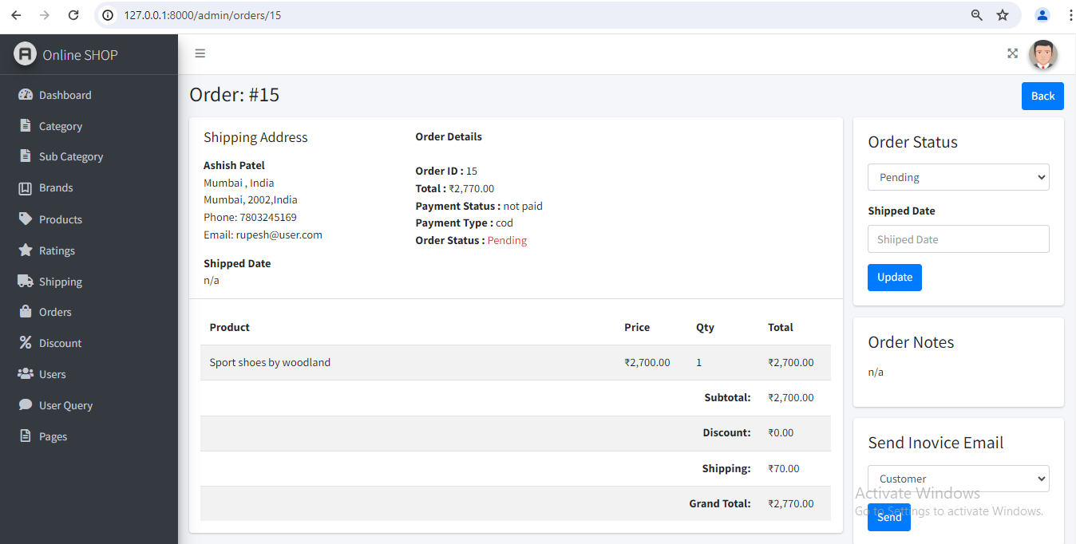
Order details admin

Slide 69
Amazing online shop Thank You
Rupesh Jadhav
Mohit Jain
Kashyap Prajapati

